Slide 1
Detection & Tracking

Slide 2
Role of a Detector
Sensing:
Physical Quantities: Detectors play a crucial role in sensing and converting physical quantities into measurable signals. These quantities can include temperature, pressure, light intensity, radiation levels, or chemical composition.
Identification and Analysis:
Identifying Substances: Detectors can identify specific particles, molecules, or compounds.
Analyzing Properties: Beyond identification, detectors analyze properties such as mass, charge, energy, or molecular structure.
Measuring:
Quantitative Analysis: Quantifies the sensed parameters or properties to allow for further processing, analysis, or decision-making based on the detected information.
Dynamic Changes: Many detectors are designed to measure changes over time, providing real-time monitoring of systems.
Notes:
Detectors play crucial roles across various fields, primarily in sensing, identifying, or measuring specific elements, energies, substances, or events. Their functions can vary widely based on the context in which they are used:
Sensing and Measurement: Detectors are employed to sense and measure various physical quantities like temperature, pressure, light intensity, radiation, or chemical composition.
Identification and Analysis: In scientific experiments, detectors are used to identify particles, molecules, or compounds by analyzing their properties such as mass, charge, or energy.
Security and Safety: Detectors are essential in security systems, like metal detectors in airports, to identify prohibited items or potential threats. They're also used in detecting harmful gases, radiation leaks, or fires for safety purposes.
Medical Applications: In medicine, detectors are used in imaging technologies like X-ray, MRI, CT scans, and PET scans to visualize internal body structures, diagnose diseases, and monitor treatments.
Environmental Monitoring: Detectors are employed to monitor environmental parameters such as air quality, water pollution, and seismic activities.
Industrial and Manufacturing Processes: Detectors are utilized in manufacturing to ensure quality control, measure parameters critical to production, and detect faults or inconsistencies in products.
Communication and Information Processing: Detectors are used in communication systems to receive, decode, and process signals in devices like antennas, radios, and telecommunications equipment.
Detectors can range from simple devices like thermometers or smoke detectors to sophisticated instruments used in scientific research, astronomy, or high-tech industries. Their significance lies in their ability to provide accurate and timely information, contributing to advancements in various fields and ensuring safety and efficiency in many applications.

Slide 3
Object Tracking
"Because tracking is easier than detection, tracking algorithms can use fewer computational resources than running an object detector on every frame." [Bolme 2010]
The methods:
Template Matching: target patch matching (mainly correlation)
Kalman Filters: linear projections state estimation - Taking into account uncertainties in measurements and motions.
Particle Filters: sequential Monte Carlo state estimation.
Mean Shift Algorithm: maximum probability density centroid shifting.
Histogram-Based Tracking: Histogram features (color, texture, gradients) tracking.
Deep Learning-Based Methods: mainly CNNs.
Graph-Based Tracking: Multiple object tracking – Model objects and relationships into nodes and edges to track in complex scenes.
*Constraints: scene complexity, objects nature computational, real-time and accuracy requirements.​
An hybrid approach is often used.
Notes:
D. S. Bolme, J. R. Beveridge, B. A. Draper and Y. M. Lui, "Visual object tracking using adaptive correlation filters," 2010 IEEE Computer Society Conference on Computer Vision and Pattern Recognition, San Francisco, CA, USA, 2010, pp. 2544-2550, doi: 10.1109/CVPR.2010.5539960.
Object tracking involves locating a specific object or multiple objects in a series of frames in a video or images. Several methods are used for object tracking, each with its own strengths and weaknesses. Here are some common methods:
Optical Flow Methods: These methods track objects by analyzing the motion of pixels between consecutive frames. They estimate the apparent motion of objects by observing the displacement of features in the image sequence.
Template Matching: Template matching involves comparing a template (an image patch representing the object to be tracked) with sub-images in the next frames. The goal is to find the best match, usually based on similarity metrics like correlation.
Kalman Filters: The Kalman Filter algorithm is a discrete time system that consists of a set of state space equations. These are used for state estimation in dynamic systems. They predict the next state of the object based on previous states and measurements, taking into account uncertainties in measurements and motions.
Mean Shift Algorithm: This algorithm is used for locating the maxima of a density function. It iteratively shifts the centroid of a window to the region with the maximum probability density within the given window.
Histogram-Based Tracking: Histograms of object features (color, texture, gradients) are used to track the object across frames. Histograms help to identify the object based on its distinctive features.
Deep Learning-Based Methods: Convolutional Neural Networks (CNNs) and other deep learning architectures have been increasingly used for object tracking. They involve training models to detect and track objects by learning from large annotated datasets.
Particle Filters: These methods represent the object's state as a set of particles, which are then propagated over time based on motion and observation models. They're effective in handling non-linear and non-Gaussian distributions.
Correlation Filters: These methods use correlation operations to track objects efficiently. They involve training a filter to respond strongly at the location of the object being tracked.
Graph-Based Tracking: Modeling objects and their relationships as nodes and edges in a graph allows for the tracking of objects in complex scenes where multiple objects interact.
The choice of tracking method often depends on various factors such as the complexity of the scene, the nature of the objects being tracked, computational requirements, accuracy needed, and real-time constraints. Often, a combination of these methods or a hybrid approach is used for robust and accurate object tracking in different scenarios.

Slide 4
Thermal imaging and tracking
Deep Learning Applications:
Utilizing deep learning models, such as convolutional neural networks (CNNs), for detecting and tracking objects in thermal imagery. This can involve training models on thermal images directly or adapting models trained on RGB data to work with thermal data.
Algorithmic Approaches (Classic computer vision):
Investigating specific algorithms developed for tracking in thermal imagery. This could include methods for object detection, motion tracking, and integrating thermal data with data from other sensors.
Statistical Analysis (Bayesian filter):
Studies that perform statistical analysis of target tracking algorithms in thermal imagery, comparing the effectiveness of different tracking approaches under various conditions.
Synthetic Data Generation:
Research into generating synthetic thermal images for training deep learning models, addressing the challenge of limited available datasets for thermal imagery.
Thermal and Visible Image Fusion:
Exploring methods for integrating thermal and visible spectrum data to improve tracking performance, especially in challenging visibility conditions.

Slide 5
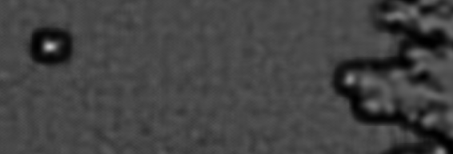

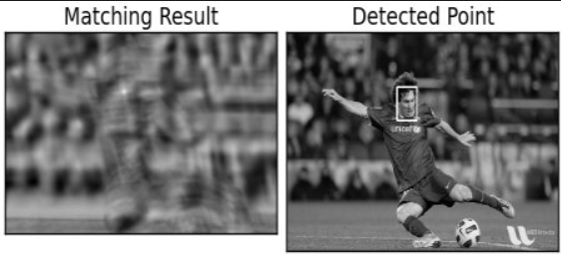
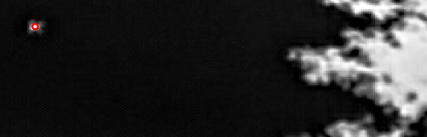
Template Matching
Example: Getting the peak position via normalized cross correlation.
corrMat = cv2.matchTemplate(image=frameGray, templ=kernel, method=cv2.TM_CCORR_NORMED)
template
Peak in correlation
Peak in correlation
kernel

Slide 6
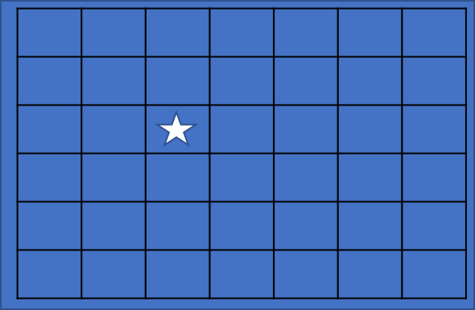
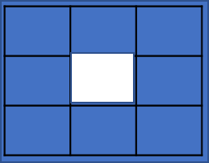

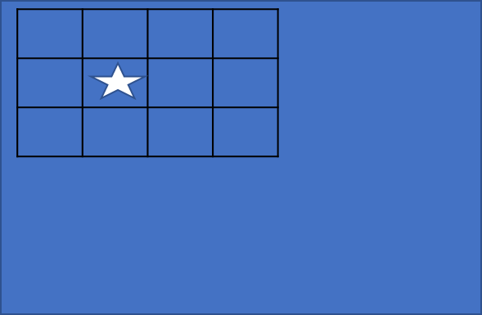
Scale-invariant tracking
*
Down
Scale
*

Slide 7
Bayesian filter
Probabilistic model used for estimating the state of a dynamic system based on sequential observations over time
Bayesian filters
(Bayesian theorem)
Others
Particle
filter
Kalman filter
Tracking and Navigation: Estimating the position and velocity of objects (vehicles, people, robots) based on sensor data (GPS, radar, lidar).
Robotics: Localizing robots within their environments and mapping those environments based on sensor inputs.
Signal Processing: Enhancing signals and removing noise from data in real-time applications.
Financial Forecasting: Predicting future states of financial markets based on historical data.

Slide 8
Variants of Bayesian filter
Probabilistic model used for estimating the state of a dynamic system based on sequential observations over time
Bayesian filters
(Bayesian theorem)
Others
Particle
filter
Kalman filter
Kalman Filter: For linear systems with Gaussian noise.
Extended Kalman Filter (EKF) and Unscented Kalman Filter (UKF): For nonlinear systems.
Particle Filter (Sequential Monte Carlo): For non-Gaussian and/or nonlinear problems, representing the system's state by a set of particles.

Slide 9
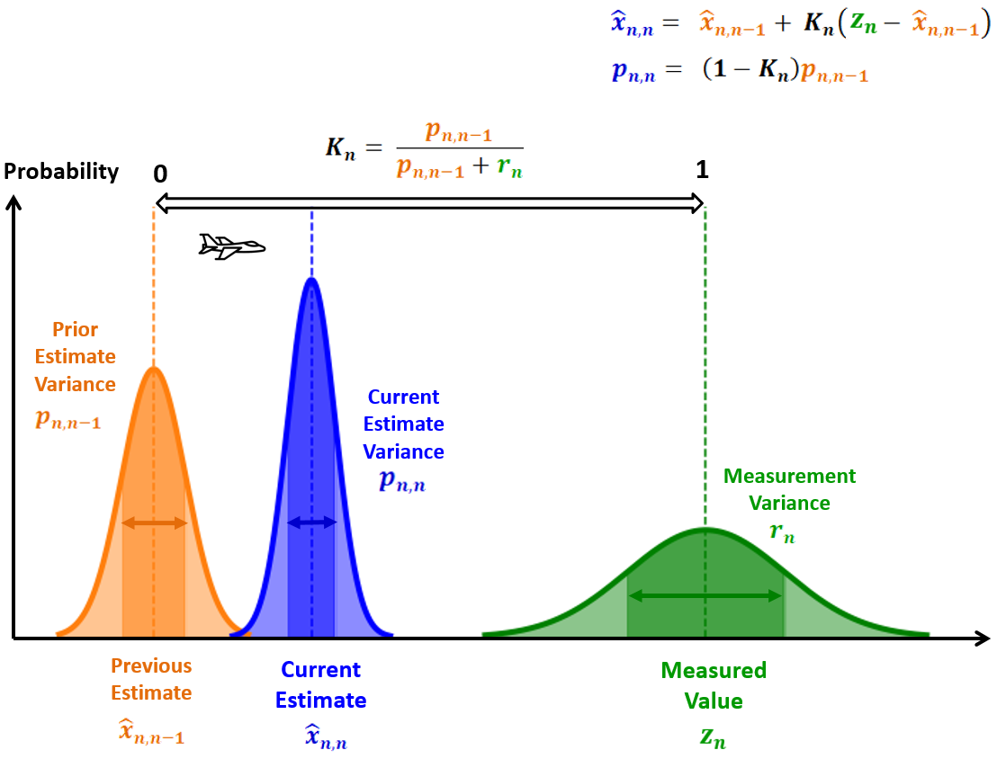
Kalman Filter (linear)
Assumptions:
Linear system
Gaussian distribution
The Kalman Filter algorithm is a discrete time system that consists of a set of state space equations for statistics and control theory.
The filter is named after Rudolf E. Kálmán, who was one of the primary developers of its theory.
The filter considers statistical noise and other inaccuracies, and produces estimates of unknown variables that tend to be more accurate than those based on a single measurement alone
“Mathematics is the language with which God has written the universe”, Galileo Galilei
Notes:
Using previous sensor data, estimated changes in parameters, and covariance information, the Kalman Filter estimates the actual output as compared to an input measurement from reality. This algorithm can be applied to position, direction, timing offsets, and accelerometer offsets to name a few.

Slide 10
Kalman Filter (linear)
Assumptions:
Linear system
Gaussian distribution
Indirect evaluation: Evaluate certain features in the state vector in a roundabout way (e.g., derive speed from locations).​
Sensor fusion: Combine 2 not so accurate sensors results to create an evaluation more accurate the two of them separately.
​
Short calculation time:​ Using Kalman gain (ratio between previous and current measurement weights) for fast convergent.
“Mathematics is the language with which God has written the universe”, Galileo Galilei
Notes:
Using previous sensor data, estimated changes in parameters, and covariance information, the Kalman Filter estimates the actual output as compared to an input measurement from reality. This algorithm can be applied to position, direction, timing offsets, and accelerometer offsets to name a few.

Slide 11

Kalman Filter (linear)
The new best estimate (Xk) is a prediction made from:
previous best estimate (Xk-1)
plus a correction for known external influence (Uk - acceleration)
F - linear transformation, old to new state
X - state vector (positions, velocity)
B - control matrix
U - control state (constant acceleration)
The new uncertainty (Pk) is a prediction made from:
old uncertainty (Pk-1 – intrinsic uncertainty)
plus some additional uncertainty from the environment ( Q – stochastic e.g., noise).
F - linear transformation, old to new state
P - uncertainty covariance (positions, velocity)
Q – environment stochastic uncertainty
Notes:
בסרטון הנוכחי אנחנו מקבלים מידע דרך קובץ – גם מחיישן הרדאר וגם מחיישן הלידאר. שימו לב איך צריך לקרוא את הקובץ data.txt. עבור שורות המתארות מדידה של ה- (L)LIDAR העמודות הן בסדר הזה: sensor_type, x_measured, y_measured, timestamp, x_groundtruth, y_groundtruth, vx_groundtruth, vy_groundtruth, yaw_groundtruth, yawrate_groundtruth. עבור שורות המתארות מדידה של הרדאר (R) העמודות הן בסדר הזה: sensor_type, rho_measured, phi_measured, rhodot_measured, timestamp, x_groundtruth, y_groundtruth, vx_groundtruth, vy_groundtruth, yaw_groundtruth, yawrate_groundtruth.

Slide 12
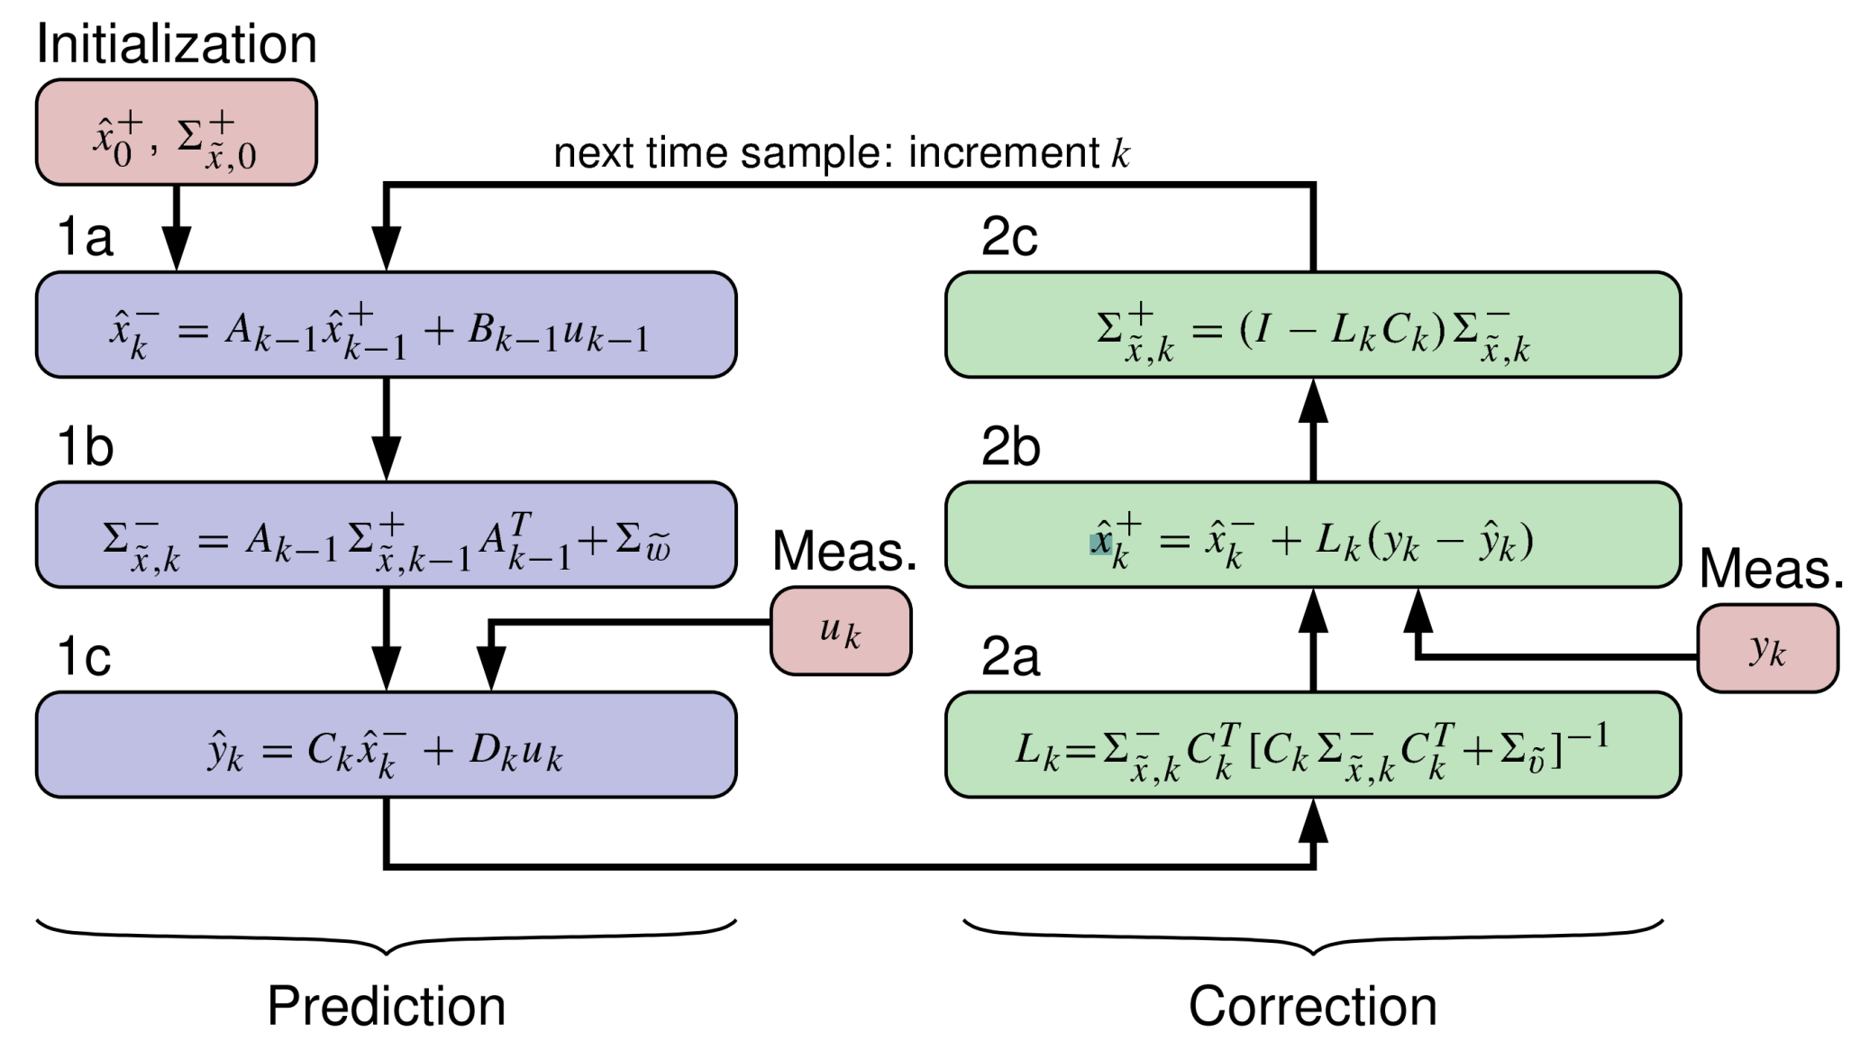
Kalman Filter (general)

Slide 13
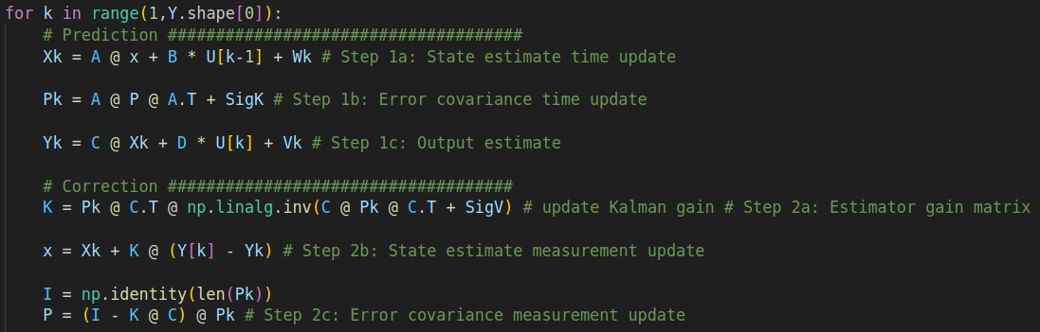
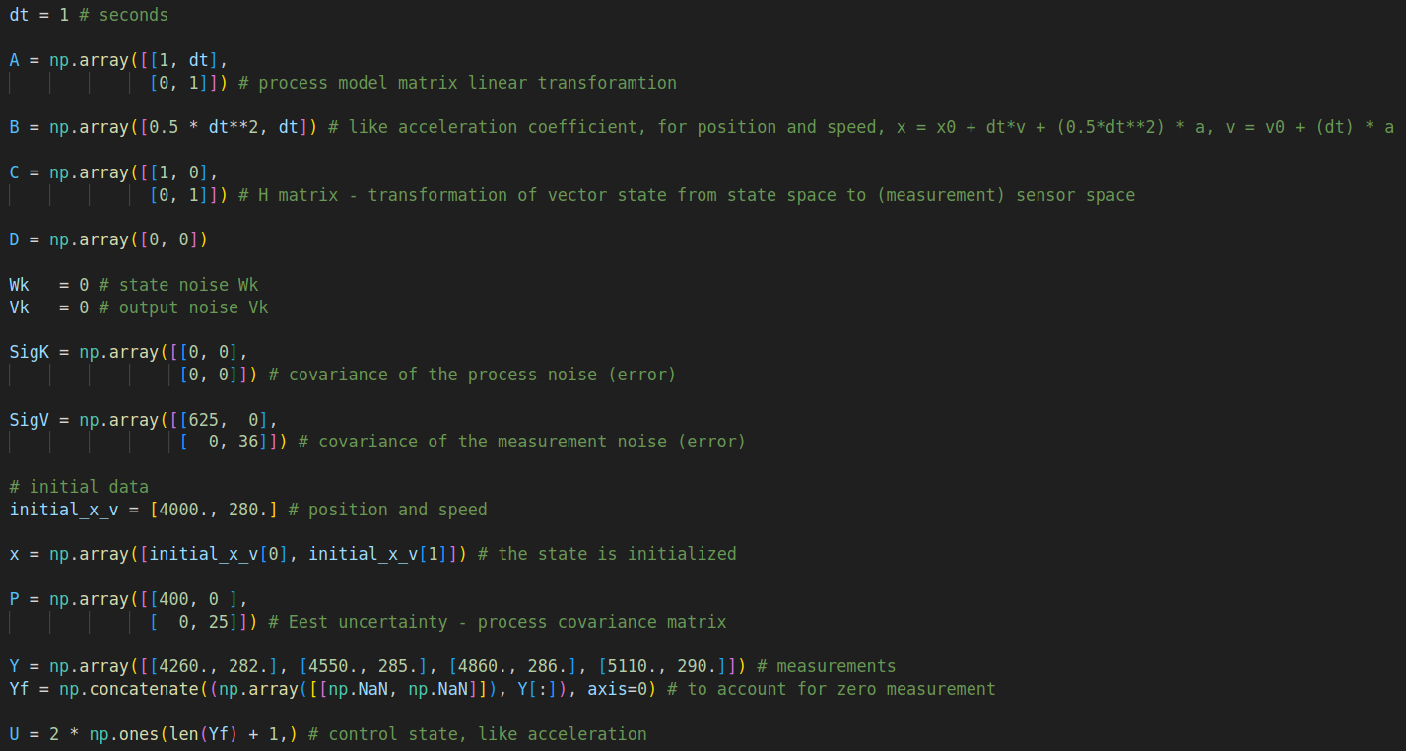

Slide 14

Alpha filter
Instead of remembering all measurements, use only the current measurement and n-1 estimate.

Slide 15
Non-Linear Kalman Filters
Extended Kalman filter (EKF)
This method performs an analytic linearization of the non-linear model equations at each point in time.
Sigma Point Kalman Filter (SPKF) – e.g., Unscented (UKF), Central-difference (CDKF)
Approach of statistical/empirical linearization instead of analytic linearization (propagate those inputs through the model equations to come up with a linear approximation). Better results than EKF with the same Computational complexity as EKF but worse conceptual complexity.
For Gaussian random variables, the CDKF is implemented quite readily and also show a little bit higher theoretic accuracy than the unscented Kalman filter
Particle filters
Particle filters give the most precise estimates of a non-linear model state. However, thousands of times more computationally complex than either the EKF or the SPKF (not real-time).

Slide 16
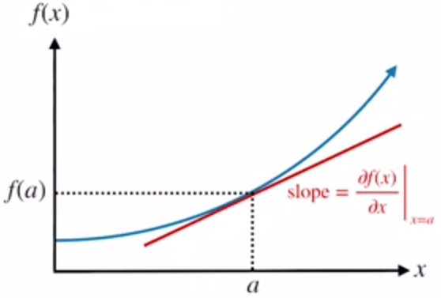
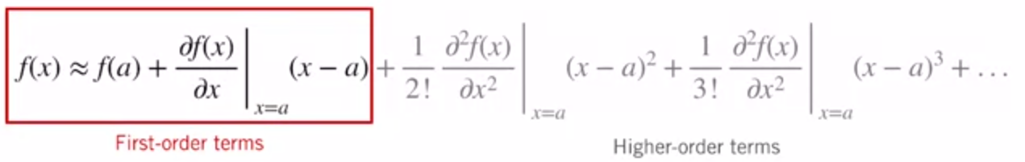
Extended Kalman Filter (non-Linear)
Extended Kalman filter (EKF) is an analytic linearization (math derivations) approximate filter for nonlinear systems.
Based on first-order linearization of the process and measurement functions
It linearizes about an estimate of the current mean and covariance.
Frequently used in joint parameter and state estimation problems for linear systems with unknown parameters
De facto standard in the theory of nonlinear state estimation, navigation systems and GPS.
Notes:
In estimation theory, the extended Kalman filter (EKF) is the nonlinear version of the Kalman filter which linearizes about an estimate of the current mean and covariance.
In the case of well defined transition models, the EKF has been considered[1] the de facto standard in the theory of nonlinear state estimation, navigation systems and GPS.

Slide 17
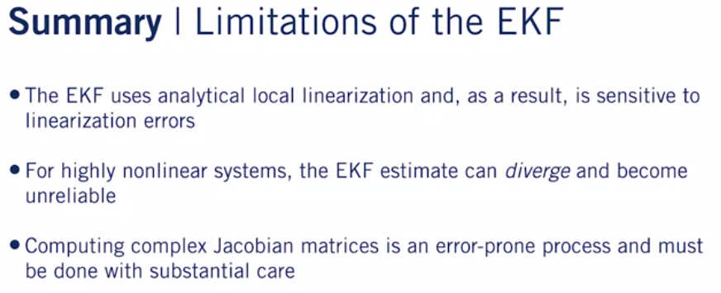
Non-Linear Kalman Filters

Slide 18
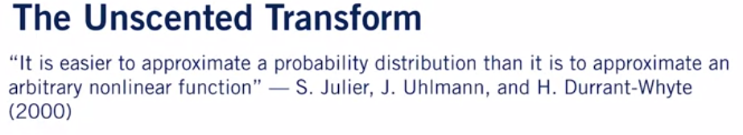
Unscented Kalman Filter (non-linear) (UKF, linear quadratic estimation)
Simplifying the EKF, linear quadratic estimation (LQE), is an algorithm that uses a series of measurements observed over time.
Estimating a joint probability distribution over the variables for each timeframe.

Slide 19
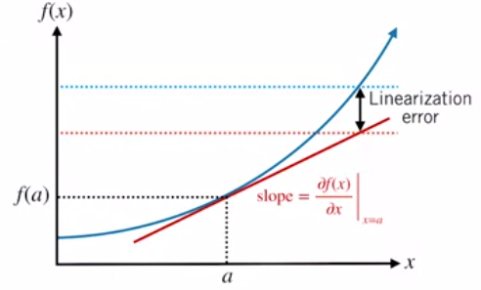
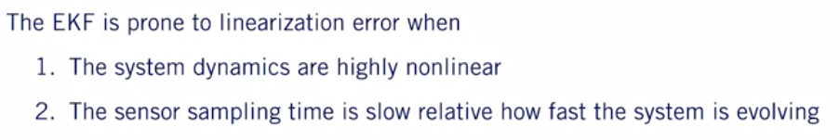
Linearization error
Kalman Filter (non-linear)
Notes:
In general, the linearization error for any function depends on two things.
The first thing is how non-linear the original function is to begin with.
If our nonlinear function varies slowly or is quite flat much of the time,
linear approximation is going to be a pretty good fit.
On the other hand, if the function varies quickly,
linear approximation is not going to do a great job of
capturing the true shape of the function over most of its domain.
The second thing linearization error depends
on is how far away from the operating point you are.
The further away you move from the operating point,
the more likely the linear approximation
is to diverge from the true function.

Slide 20
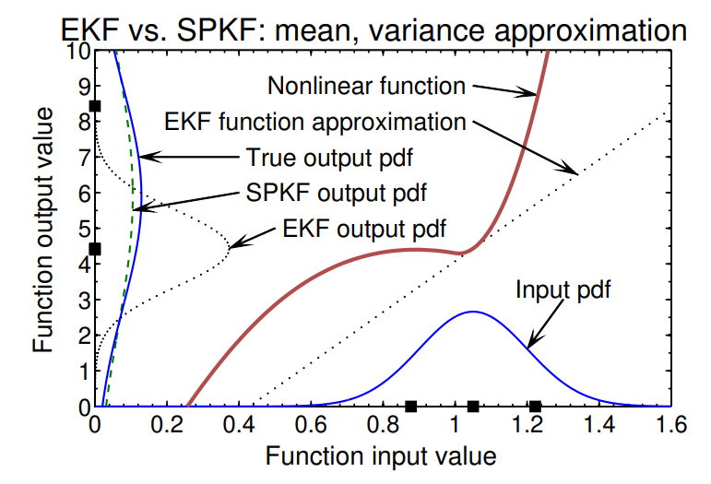
Central-Difference (non-linear) Kalman Filter (CDKF)
1D
1D requires 2L+1 = 3 sigma-points: the mean and mean +/- std

Slide 21
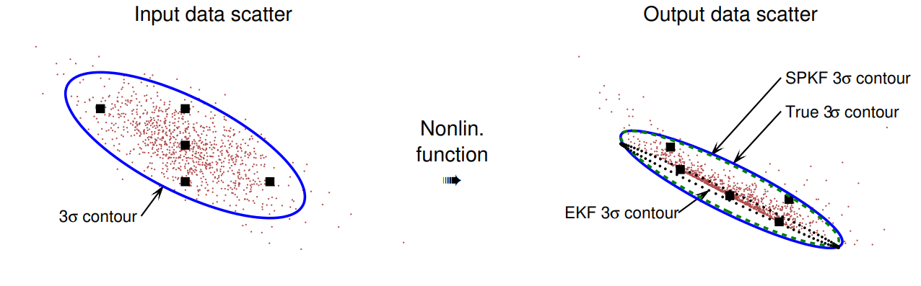
Central-Difference (non-linear) Kalman Filter (CDKF)
2D
2D requires 2D+1 = 5 sigma-points: the mean and mean +/- std per dimension

Slide 22
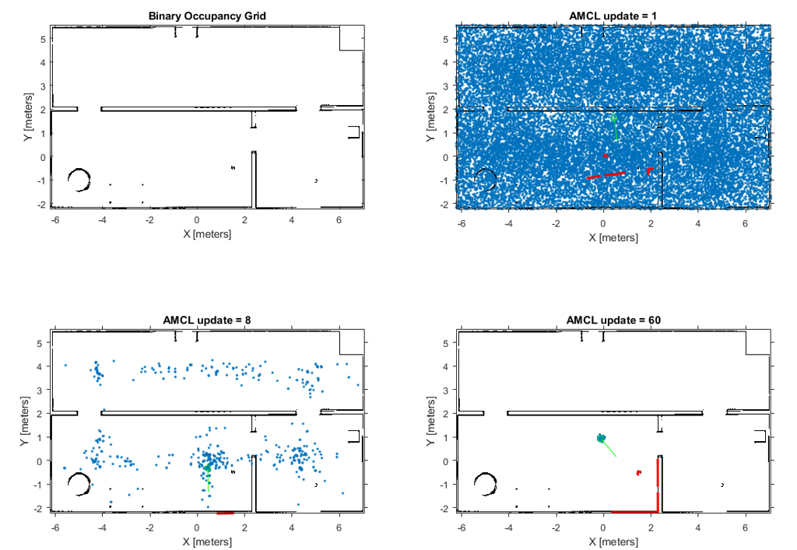
Particle Filters
Particle Filter (Sequential Monte Carlo): For non-Gaussian and/or nonlinear problems, representing the belief by a set of samples.
Adaptive Monte Carlo Localization (AMCL)
Notes:
The Adaptive Monte Carlo Localization (AMCL) is a probabilistic localization module which estimates the position and orientation (i.e. Pose) for mobile robot localization problem. However, AMCL performs poorly on localization when robot navigates to a featureless environment. an enhanced AMCL is proposed through using the information from laser scan points to improve the preciseness and robustness of the localization problem
Adaptive Monte Carlo Localization (AMCL) is a probabilistic localization module which estimates the position and orientation (i.e. Pose) of a robot in a given known map using a 2D laser scanner.

Slide 23
Mean Shift Algorithm

Slide 24
Deep Learning-Based Methods

Slide 25
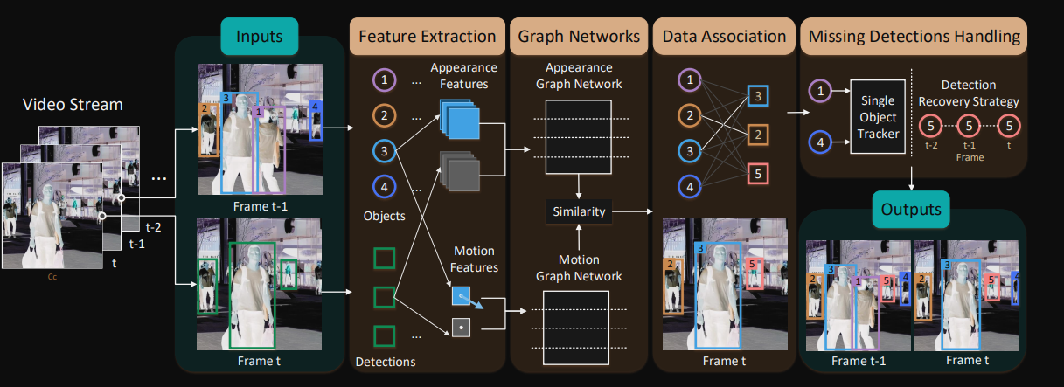
Graph-Based Tracking
Notes:
Pipeline of our Multiple object tracking (MOT) model. Inputs are the frame t − 1, the frame t, the object set Ot from frame t and the detection set Dt at frame t. Outputs are tracking results. For example, there are four objects from frame t − 1 and three detections from frame t, and their features are extracted and sent into the graph networks. Afterwards, data association and missing detections handling are performed.

Slide 26
Thanks

Slide 28
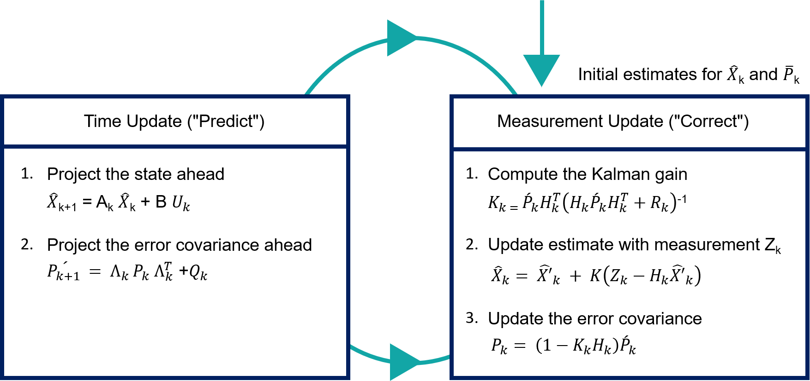

Slide 29
Kalman Filters
Localization filters x(t-1) -> x(t)
Real value – state vector (position, orientation, speed, acceleration…)
Uncertainty (inherent sensor noise) – from this derive exact evaluation (probabilistic robots):
1. Indirect evaluation: Evaluate certain features in the state vector in a roundabout way (e.g., derive speed from locations).
2. Sensor fusion: Combine 2 not so accurate sensors results to create an evaluation more accurate the two of them separately.
Short calculation time:
by using kalman gain (ratio between previous and current measurement weights) for fast convergent. Useful: Kalman filter will calculate the Kalman gain at every stage.
Notes:
an iterative mathematical process, meaning it repeats itself, which uses a set of equations and data that steadily come from the sensors in order to quickly evaluate the true value, which can be speed or location, of an object that is measured, while the measured attributes contain uncertainty, noise and randomness.
It is a part of a big family of Bayesian filters which are filters that operate according to they Bayes Theorem.
Kalman Filters are powerful tools in estimation theory, used for predicting the state of dynamic systems in the presence of noise. There are several variants of Kalman Filters, each designed to handle specific types of systems and data.
Histogram – multimodal, per bin probability, hold several guesses of location, can be in any bin with some probability. Discrete – must be in the entire bin or not at all, requires many bins for high-res (computationally costly).
Kalman – unimodal can be in only a single location with some uncertainty. Continuous – can be at every point. Can move to every point so cost less.

